Slide 1

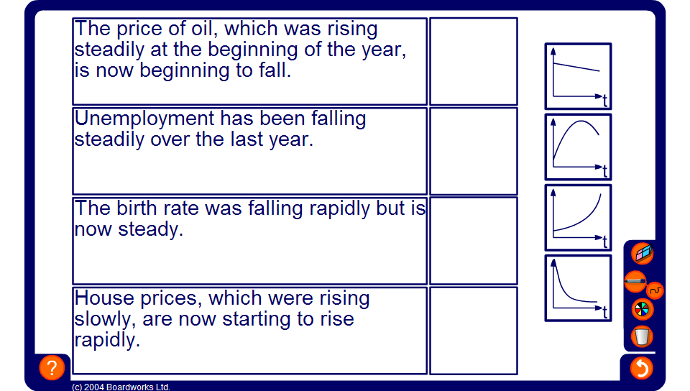

Matching graphs to statements
Notes:
Establish that if something is rising rapidly over time it will have a steeper and steeper gradient. If something is falling rapidly it will have a steeper negative (or downward) gradient. If something is rising or falling steadily then the graph will be straight.
Ask pupils what a horizontal section of graph would represent.
Each of the graphs in this example illustrates trends rather than accurate information.

